Slide 1
Module-4
Data Collection
Reference: C R Kothari, Research Methodology Text Book
Compiled and ppt by Shivakumara T, Assistant Professor, Dept. of MCA, BMSITM

Slide 2
Module-5 – Interpretation and Report Writing, Intellectual Property (IP) Acts – 06 Hours
Hour | Topics will be Covered
1 | Meaning, Technique and Precaution in Interpretation, Significance of Report Writing
2 | Different steps in Writing Report
3 | Layouts, Mechanics, and Precautions of writing a Research Reports
4 | Different types of IPs and its importance in the present scenario.
5 | Patent Acts: Indian Patent Acts 1970, Design Act, Industrial design act 2000
6 | Copyrights Act 1957, Trademark act 1999, and Summary of RM & IPR Concepts

Slide 3

Interpretation and Report writing
After collecting and analyzing the data, the
researcher has to accomplish the task of drawing
inferences followed by report writing.
It is only through interpretation that the researcher can expose relations and processes that underlie his findings.
In case of hypotheses testing studies, if hypotheses are tested and upheld several times, the researcher may arrive at generalizations.
But in case the researcher had no hypothesis to start with, he would try to explain his findings on the basis of some theory.
This may at times result in new questions, leading to further researches.

Slide 4
Interpretation and Report writing continued….
All this analytical information and consequential inference(s) may well be communicated, preferably through research report, to the consumers of research results who may be either an individual or a group of individuals or some public/private organisation.

Slide 5
Meaning of interpretation
Interpretation refers to the task of drawing inferences from the collected facts after an analytical and/or experimental study. In fact, it is a search for broader meaning of research findings. The task of interpretation has two major aspects viz.,
(i) the effort to establish continuity in research through linking the results of a given study with those of another, and
(ii) the establishment of some explanatory concepts.
“In one sense, interpretation is concerned with relationships within the collected data, partially overlapping analysis.
Interpretation also extends beyond the data of the study to include the results of other research, theory and hypotheses.”

Slide 6
Meaning of interpretation, technique of interpretation
Interpretation is the device through which the factors that seem to explain what has been observed by researcher in the course of the study can be better understood and it also provides a theoretical conception which can serve as a guide for further researches.

Slide 7
WHY INTERPRETATION?
Interpretation is essential for the simple reason that the usefulness and utility of research findings lie in proper interpretation. It is being considered a basic component of research process because of the following reasons:
[1]
It is through interpretation that the researcher can well understand the abstract principle that works beneath his findings.
Through this he can link up his findings with those of other studies, having the same abstract principle, and thereby can predict about the concrete world of events.
Fresh inquiries can test these predictions later on.
This way the continuity in research can be maintained.

Slide 8
WHY INTERPRETATION? continued...
[ii]
Interpretation leads to the establishment of explanatory concepts that can serve as a guide for future research studies;
it opens new avenues of intellectual adventure and stimulates the quest for more knowledge.
[iii]
Researcher can better appreciate only through interpretation why his findings are what they are and can make others to understand the real significance of his research findings.

Slide 9
WHY INTERPRETATION? continued...
[iv]
The interpretation of the findings of exploratory research study often results into hypotheses for experimental research and as such interpretation is involved in the transition from exploratory to experimental research.
Since an exploratory study does not have a hypothesis to start with, the findings of such a study have to be interpreted on a post-factum basis in which case the interpretation is technically described as ‘post factum’ interpretation.

Slide 10
TECHNIQUE OF INTERPRETATION
The task of interpretation is not an easy job, rather it requires a great skill and dexterity on the part of researcher.
Interpretation is an art that one learns through practice and experience.
The researcher may, at times, seek the guidance from experts for accomplishing the task of interpretation.

Slide 11
TECHNIQUE OF INTERPRETATION Continued...
The technique of interpretation often involves the following steps:
[1]
Researcher must give reasonable explanations of the relations which he has found and he must interpret the lines of relationship in terms of the underlying processes and must try to find out the thread of uniformity that lies under the surface layer of his diversified research findings.
In fact, this is the technique of how generalization should be done and concepts be formulated.

Slide 12
TECHNIQUE OF INTERPRETATION Continued...
[2]
Extraneous information, if collected during the study, must be considered while interpreting the final results of research study, for it may prove to be a key factor in understanding the problem under consideration.

Slide 13
TECHNIQUE OF INTERPRETATION Continued...
[3]
It is advisable, before embarking upon final interpretation, to consult someone having insight into the study and who is frank and honest and will not hesitate to point out omissions and errors in logical argumentation.
Such a consultation will result in correct interpretation and, thus, will enhance the utility of research results

Slide 14
TECHNIQUE OF INTERPRETATION Continued...
[4]
Researcher must accomplish the task of interpretation only after considering all relevant factors affecting the problem to avoid false generalization.
He must be in no hurry while interpreting results, for quite often the conclusions, which appear to be all right at the beginning, may not at all be accurate.

Slide 15
PRECAUTIONS IN INTERPRETATION
Even if the data are properly collected and analysed, wrong interpretation would lead to inaccurate conclusions.
It is, therefore, absolutely essential that the task of interpretation be accomplished with patience in an impartial manner and also in correct perspective.

Slide 16
PRECAUTIONS IN INTERPRETATION Continued...
Researcher must pay attention to the following points for correct interpretation:
[i] At the outset, researcher must invariably satisfy himself that
(a) the data are appropriate, trustworthy and adequate for drawing inferences;
(b) the data reflect good homogeneity; and that
(c) proper analysis has been done through statistical methods.

Slide 17
PRECAUTIONS IN INTERPRETATION Continued...
[ii]
The researcher must remain cautious about the errors that can possibly arise in the process of interpreting results.
Errors can arise due to false generalization and/or due to wrong interpretation of statistical measures, such as the application of findings beyond the range of observations, identification of correlation with causation and the like.
Another major pitfall is the tendency to affirm that definite relationships exist on the basis of confirmation of particular hypotheses.

Slide 18
PRECAUTIONS IN INTERPRETATION Continued...
In fact, the positive test results accepting the hypothesis must be interpreted as “being in accord” with the hypothesis, rather than as “confirming the validity of the hypothesis”.
The researcher must remain vigilant about all such things so that false generalization may not take place.
He should be well equipped with and must know the correct use of statistical measures for drawing inferences concerning his study.

Slide 19
PRECAUTIONS IN INTERPRETATION Continued...
[iii]
He must always keep in view that the task of interpretation is very much intertwined with analysis and cannot be distinctly separated.
As such he must take the task of interpretation as a special aspect of analysis and accordingly must take all those precautions that one usually observes while going through the process of analysis viz., precautions concerning the reliability of data, computational checks, validation and comparison of results.

Slide 20
PRECAUTIONS IN INTERPRETATION Continued...
[iv]
He must never lose sight of the fact that his task is not only to make sensitive observations of relevant occurrences, but also to identify and disengage the factors that are initially hidden to the eye.
This will enable him to do his job of interpretation on proper lines.
Broad generalisation should be avoided as most research is not amenable to it because the coverage may be restricted to a particular time, a particular area and particular conditions.
Such restrictions, if any, must invariably be specified and the results must be framed within their limits.

Slide 21
PRECAUTIONS IN INTERPRETATION Continued...
[v]
The researcher must remember that “ideally in the course of a research study, there should be constant interaction between initial hypothesis, empirical observation and theoretical conceptions.
It is exactly in this area of interaction between theoretical orientation and empirical observation that opportunities for originality and creativity lie.
He must pay special attention to this aspect while engaged in the task of interpretation.

Slide 22
Significance of Report Writing
Research report is considered a major component of the research study for the research task remains incomplete till the report has been presented and/or written.
The purpose of research is not well served unless the findings are made known to others.
Research results must invariably enter the general store of knowledge.
As a matter of fact even the most brilliant hypothesis, highly well designed and conducted research study, and the most striking generalizations and findings are of little value unless they are effectively communicated to others.
All this explains the significance of writing research report.
Writing of report is the last step in a research study and requires a set of skills somewhat different from those called for in respect of the earlier stages of research.
This task should be accomplished by the researcher with utmost care; he may seek the assistance and guidance of experts for the purpose.

Slide 23

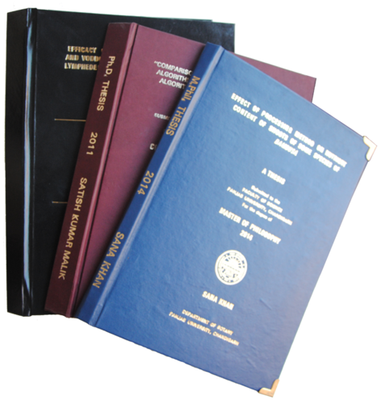
Different steps in writing report
The usual steps involved in writing report are:
(a) logical analysis of the subject-matter;
(b) preparation of the final outline;
(c) preparation of the rough draft;
(d) rewriting and polishing;
(e) preparation of the final bibliography;
and
(f) writing the final draft.

Slide 24
Logical analysis of the subject matter:
It is the first step which is primarily concerned with the development of a subject. There are two ways in which to develop a subject
(a) logically - The logical development is made on the basis of mental connections and associations between the one thing and another by means of analysis. Logical treatment often consists in developing the material from the simple possible to the most complex structures.
(b) chronologically - Chronological development is based on a connection or sequence in time or occurrence. The directions for doing or making something usually follow the chronological order.

Slide 25
Preparation of the final outline:
It is the next step in writing the research report “Outlines are the framework upon which long written works are constructed.
They are an aid to the logical organisation of the material and a reminder of the points to be stressed in the report

Slide 26
Preparation of the rough draft:
This follows the logical analysis of the subject and the preparation of the final outline.
Such a step is of utmost importance for the researcher now sits to write down what he has done in the context of his research study.
He will write down the procedure adopted by him in collecting the material for his study along with various limitations faced by him, the technique of analysis adopted by him, the broad findings and generalizations and the various suggestions he wants to offer regarding the problem concerned.

Slide 27
Rewriting and polishing of the rough draft:
This step happens to be most difficult part of all formal writing. Usually this step requires more time than the writing of the rough draft.
The careful revision makes the difference between a mediocre and a good piece of writing.
While rewriting and polishing, one should check the report for weaknesses in logical development or presentation.
The researcher should also “see whether or not the material, as it is presented, has unity and cohesion; does the report stand upright and firm and exhibit a definite pattern.
In addition the researcher should give due attention to the fact that in his rough draft he has been consistent or not.
He should check the mechanics of writing—grammar, spelling and usage.

Slide 28
Preparation of the final bibliography:
The bibliography, which is generally appended to the research report, is a list of books in some way pertinent to the research which has been done.
It should contain all those works which the researcher has consulted.
The bibliography should be arranged alphabetically and may be divided into two parts;
the first part may contain the names of books and pamphlets, and
the second part may contain the names of magazine and newspaper articles.

Slide 29
Preparation of the final bibliography: continued...
The entries in bibliography should be made adopting the following order:
For books and pamphlets the order may be as under:
1. Name of author, last name first.
2. Title, underlined to indicate italics.
3. Place, publisher, and date of publication.
4. Number of volumes.
Example Kothari, C.R., Quantitative Techniques, New Delhi, Vikas Publishing House Pvt. Ltd., 1978.

Slide 30
Preparation of the final bibliography: continued...
For magazines and newspapers the order may be as under:
1. Name of the author, last name first.
2. Title of article, in quotation marks.
3. Name of periodical, underlined to indicate italics.
4. The volume or volume and number.
5. The date of the issue.
6. The pagination.
Example Robert V. Roosa, “Coping with Short-term International Money Flows”, The Banker, London, September, 1971, p. 995.

Slide 31
Writing the final draft:
This constitutes the last step.
The final draft should be written in a concise and objective style and in simple language, avoiding vague expressions such as “it seems”, “there may be”, and the like ones.
While writing the final draft, the researcher must avoid abstract terminology and technical jargon.
Illustrations and examples based on common experiences must be incorporated in the final draft as they happen to be most effective in communicating the research findings to others.

Slide 32
Writing the final draft continued...
A research report should not be dull, but must enthuse people and maintain interest and must show originality.
It must be remembered that every report should be an attempt to solve some intellectual problem and must contribute to the solution of a problem and must add to the knowledge of both the researcher and the reader.

Slide 33
LAYOUT OF THE RESEARCH REPORT:
Anybody, who is reading the research report, must necessarily be conveyed enough about the study so that he can place it in its general scientific context, judge the adequacy of its methods and thus form an opinion of how seriously the findings are to be taken.
For this purpose there is the need of proper layout of the report.
The layout of the report means as to what the research report should contain.
A comprehensive layout of the research report should comprise (A) preliminary pages;
(B) the main text; and
(C) the end matter.

Slide 34
(A) Preliminary Pages:
(B) Main Text
In its preliminary pages the report should carry a title and date, followed by acknowledgements in the form of ‘Preface’ or ‘Foreword’. Then there should be a table of contents followed by list of tables and illustrations so that the decision-maker or anybody interested in reading the report can easily locate the required information in the report.

Slide 35
(B) Main Text continued
The main text provides the complete outline of the research report along with all details. Title of the research study is repeated at the top of the first page of the main text and then follows the other details on pages numbered consecutively, beginning with the second page.
Each main section of the report should begin on a new page.
The main text of the report should have the following sections:
(i) Introduction;
(ii) Statement of findings and recommendations;
(iii) The results;
(iv) The implications drawn from the results; and
(v) The summary.

Slide 36
(i) Introduction:
The purpose of introduction is to introduce the research project to the readers.
It should contain a clear statement of the objectives of research i.e., enough background should be given to make clear to the reader why the problem was considered worth investigating.
A brief summary of other relevant research may also be stated so that the present study can be seen in that context.
The hypotheses of study, if any, and the definitions of the major concepts employed in the study should be explicitly stated in the introduction of the report.

Slide 37
(i) Introduction continued...
The methodology adopted in conducting the study must be fully explained.
The scientific reader would like to know in detail about such thing:
How was the study carried out?
What was its basic design? If the study was an experimental one, then what were the experimental manipulations?
If the data were collected by means of questionnaires or interviews, then exactly what questions were asked

Slide 38
(i) Introduction continued...
If measurements were based on observation, then
what instructions were given to the observers?
Regarding the sample used in the study the reader should be told:
Who were the subjects?
How many were there?
How were they selected? All these questions are crucial for estimating the probable limits of generalizability of the findings.
The statistical analysis adopted must also be clearly stated. In addition to all this, the scope of the study should be stated and the boundary lines be demarcated.
The various limitations, under which the research project was completed, must also be narrated.

Slide 39
(ii) Statement of findings and recommendations:
After introduction, the research report must contain a statement of findings and recommendations in non-technical language so that it can be easily understood by all concerned.
If the findings happen to be extensive, at this point they should be put in the summarised form.

Slide 40
(iii) The results:
A detailed presentation of the findings of the study, with supporting data in the form of tables and charts together with a validation of results, is the next step in writing the main text of the report.
This generally comprises the main body of the report, extending over several chapters.
The result section of the report should contain statistical summaries and reductions of the data rather than the raw data.
All the results should be presented in logical sequence and splitted into readily identifiable sections.

Slide 41
(iii) The results continued...
All relevant results must find a place in the report. But how one is to decide about what is relevant is the basic question.
Quite often guidance comes primarily from the research problem and from the hypotheses, if any, with which the study was concerned.
But ultimately the researcher must rely on his own judgement in deciding the outline of his report.
“Nevertheless, it is still necessary that he states clearly the problem with which he was concerned, the procedure by which he worked on the problem, the conclusions at which he arrived, and the bases for his conclusions

Slide 42
(iv) The implications drawn from the results:
Toward the end of the main text, the researcher should again put down the results of his research clearly and precisely.
He should, state the implications that flow from the results of the study, for the general reader is interested in the implications for understanding the human behaviour.

Slide 43
(iv) The implications drawn from the results continued...
(a) A statement of the inferences drawn from the present study which may be expected to apply in similar circumstances.
(b) The conditions of the present study which may limit the extent of legitimate generalizations of the inferences drawn from the study.
(c) Thc relevant questions that still remain unanswered or new questions raised by the study along with suggestions for the kind of research that would provide answers for them.

Slide 44
(iv) The implications drawn from the results continued...
It is considered a good practice to finish the report with a short conclusion which summarises and recapitulates the main points of the study.
The conclusion drawn from the study should be clearly related to the hypotheses that were stated in the introductory section.
At the same time, a forecast of the probable future of the subject and an indication of the kind of research which needs to be done in that particular field is useful and desirable.

Slide 45
(v) The summary:
It has become customary to conclude the research report with a very brief summary, resting in brief the research problem, the methodology, the major findings and the major conclusions drawn from the research results

Slide 46
Types of reports: Research reports vary greatly in length and type
(A) Technical Report
(B) Popular Report

Slide 47
Types of reports continued….
i. Business Reports in the letters form, just one or two pages in length.
ii. Banks, insurance organisations and financial institutions are generally fond of the short balance-sheet type of tabulation for their annual reports to their customers and shareholders.
Iii. Mathematicians prefer to write the results of their investigations in the form of algebraic notations.
Iv. Chemists report their results in symbols and formulae.

Slide 48
Types of reports continued...
v. Students of literature usually write long reports presenting the critical analysis of some writer or period or the like with a liberal use of quotations from the works of the author under discussion.
vi. In the field of education and psychology, the favourite form is the report on the results of experimentation accompanied by the detailed statistical tabulations.
vii. Clinical psychologists and social pathologists frequently find it necessary to make use of the case-history form.

Slide 49
Types of reports continued...
viii. News items in the daily papers are also forms of report writing.
They represent firsthand on-thescene accounts of the events described or compilations of interviews with persons who were on the scene.
In such reports the first paragraph usually contains the important information in detail and the succeeding paragraphs contain material which is progressively less and less important.

Slide 50
Types of reports continued...
ix. Book-reviews which analyze the content of the book and report on the author’s intentions, his success or failure in achieving his aims, his language, his style, scholarship, bias or his point of view.
Such reviews also happen to be a kind of short report. The reports prepared by governmental bureaus, special commissions, and similar other organisations are generally very comprehensive reports on the issues involved.
Such reports are usually considered as important research products.
Similarly, Ph.D. theses and dissertations are also a form of report-writing, usually completed by students in academic institutions.

Slide 51
Types of reports continued...
The above narration throws light on the fact that the results of a research investigation can be presented in a number of ways viz., a technical report, a popular report, an article, a monograph or at times even in the form of oral presentation.
Which method(s) of presentation to be used in a particular study depends on the circumstances under which the study arose and the nature of the results.
A technical report is used whenever a full written report of the study is required whether for record-keeping or for public dissemination.
A popular report is used if the research results have policy implications.
We give below a few details about the said two types of reports:

Slide 52
(A) Technical Report:
In the technical report the main emphasis is on
(i) the methods employed,
(ii) assumptions made in the course of the study,
(iii) the detailed presentation of the findings including their limitations and supporting data.

Slide 53
(A) Technical Report continued...: A general outline of a technical report can be as follows:
In the technical report the main emphasis is on
(i) the methods employed,
(ii) assumptions made in the course of the study,
(iii) the detailed presentation of the findings including their limitations and supporting data.

Slide 54
A general outline of a technical report can be as follows:
1. Summary of results: A brief review of the main findings just in two or three pages.
2. Nature of the study: Description of the general objectives of study, formulation of the problem in operational terms, the working hypothesis, the type of analysis and data required, etc.
3. Methods employed: Specific methods used in the study and their limitations.
For instance, in sampling studies we should give details of sample design viz., sample size, sample selection, etc.

Slide 55
A general outline of a technical report can be as follows continued...:
4. Data: Discussion of data collected, their sources, characteristics and limitations. If secondary data are used, their suitability to the problem at hand be fully assessed. In case of a survey, the manner in which data were collected should be fully described.
5. Analysis of data and presentation of findings: The analysis of data and presentation of the findings of the study with supporting data in the form of tables and charts be fully narrated. This, in fact, happens to be the main body of the report usually extending over several chapters.
6. Conclusions: A detailed summary of the findings and the policy implications drawn from the results be explained.

Slide 56
A general outline of a technical report can be as follows continued...:
7. Bibliography: Bibliography of various sources consulted be prepared and attached.
8. Technical appendices: Appendices be given for all technical matters relating to questionnaire, mathematical derivations, elaboration on particular technique of analysis and the like ones.
9. Index: Index must be prepared and be given invariably in the report at the end.

Slide 57
(B) Popular Report:
The popular report is one which gives emphasis on simplicity and attractiveness.
The simplification should be sought through clear writing, minimization of technical, particularly mathematical, details and liberal use of charts and diagrams.
Attractive layout along with large print, many subheadings, even an occasional cartoon now and then is another characteristic feature of the popular report.
Besides, in such a report emphasis is given on practical aspects and policy implications.

Slide 58
We give below a general outline of a popular report.
1. The findings and their implications: Emphasis in the report is given on the findings of most practical interest and on the implications of these findings.
2. Recommendations for action: Recommendations for action on the basis of the findings of the study is made in this section of the report.
3. Objective of the study: A general review of how the problem arise is presented along with the specific objectives of the project under study.

Slide 59
We give below a general outline of a popular report.
4. Methods employed: A brief and non-technical description of the methods and techniques used, including a short review of the data on which the study is based, is given in this part of the report.
5. Results: This section constitutes the main body of the report wherein the results of the study are presented in clear and non-technical terms with liberal use of all sorts of illustrations such as charts, diagrams and the like ones.
6. Technical appendices: More detailed information on methods used, forms, etc. is presented in the form of appendices. But the appendices are often not detailed if the report is entirely meant for general public.

Slide 60
Oral presentation:
The merit of this approach lies in the fact that it provides an opportunity for give-and-take decisions which generally lead to a better understanding of the findings and their implications.
But the main demerit of this sort of presentation is the lack of any permanent record concerning the research details and it may be just possible that the findings may fade away from people’s memory even before an action is taken.

Slide 61
Oral presentation continued...:
Oral presentation is effective when supplemented by various visual devices.
Use of slides,
wall charts and blackboards is quite helpful in contributing to clarity and in reducing the boredom, if any.
Distributing a board outline,
with a few important tables and charts concerning the research results, makes the listeners attentive who have a ready outline on which to focus their thinking.

Slide 62
Mechanics of writing a research report:
1. Size and physical design: The manuscript should be written on unruled paper 8-1/2″ × 11″ in size. If it is to be written by hand, then black or blue-black ink should be used. A margin of at least one and one-half inches should be allowed at the left hand and of at least half an inch at the right hand of the paper. There should also be one-inch margins, top and bottom. The paper should be neat and legible. If the manuscript is to be typed, then all typing should be double-spaced on one side of the page only except for the insertion of the long quotations.
2. Procedure: Various steps in writing the report should be strictly adhered (All such steps have already been explained earlier in this chapter).
3. Layout: Keeping in view the objective and nature of the problem, the layout of the report should be thought of and decided and accordingly adopted (The layout of the research report and various types of reports have been described in this chapter earlier which should be taken as a guide for report-writing in case of a particular problem).

Slide 63
Mechanics of writing a research report:
4. Treatment of quotations: Quotations should be placed in quotation marks and double spaced, forming an immediate part of the text. But if a quotation is of a considerable length (more than four or five type written lines) then it should be single-spaced and indented at least half an inch to the right of the normal text margin.
5. The footnotes: footnotes are meant for cross references, citation of authorities and sources, acknowledgement and elucidation or explanation of a point of view. Footnotes are placed at the bottom of the page on which the reference or quotation which they identify or supplement ends. Footnotes should be numbered consecutively, usually beginning with 1 in each chapter separately. Footnotes are always typed in single space though they are divided from one another by double space
6. Documentation style: Regarding documentation, the first footnote reference to any given work should be complete in its documentation, giving all the essential facts about the edition used.

Slide 64
Mechanics of writing a research report continued….
(i) Regarding the single-volume reference
1. Author’s name in normal order (and not beginning with the last name as in a bibliography) followed by a comma;
2. Title of work, underlined to indicate italics;
3. Place and date of publication;
4. Pagination references (The page number).
Example John Gassner, Masters of the Drama, New York: Dover Publications, Inc. 1954, p. 315.

Slide 65
Mechanics of writing a research report continued….
(ii) Regarding multivolumed reference
1. Author’s name in the normal order;
2. Title of work, underlined to indicate italics;
3. Place and date of publication;
4. Number of volume;
5. Pagination references (The page number).

Slide 66
Mechanics of writing a research report continued….
(iii) Regarding works arranged alphabetically
For works arranged alphabetically such as encyclopedias and dictionaries,
no pagination reference is usually needed. In such cases the order is illustrated as under:
Example 1 “Salamanca,” Encyclopaedia Britannica, 14th Edition.
Example 2 “Mary Wollstonecraft Godwin,” Dictionary of national biography. But if there should be a detailed reference to a long encyclopedia article, volume and pagination reference may be found necessary.

Slide 67
Mechanics of writing a research report continued….
(iv) Regarding periodicals reference
1. Name of the author in normal order;
2. Title of article, in quotation marks;
3. Name of periodical, underlined to indicate italics;
4. Volume number;
5. Date of issuance;
6. Pagination.

Slide 68
Mechanics of writing a research report continued….
(v) Regarding anthologies and collections reference Quotations from anthologies or collections of literary works must be acknowledged not only by author, but also by the name of the collector.
(vi) Regarding second-hand quotations reference In such cases the documentation should be handled as follows:
1. Original author and title;
2. “quoted or cited in,”;
3. Second author and work.
Example J.F. Jones, Life in Ploynesia, p. 16, quoted in History of the Pacific Ocean area, by R.B. Abel, p. 191.

Slide 69
Mechanics of writing a research report continued….
(vii) Case of multiple authorship
If there are more than two authors or editors, then in the documentation the name of only the first is given and the multiple authorship is indicated by “et al.” or “and others”.
7. Punctuation and abbreviations in footnotes:
Latin abbreviations are quite often used in bibliographies and footnotes to eliminate tedious repetition.

Slide 70
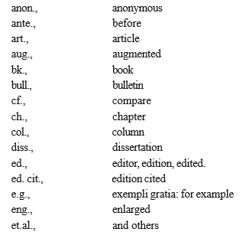
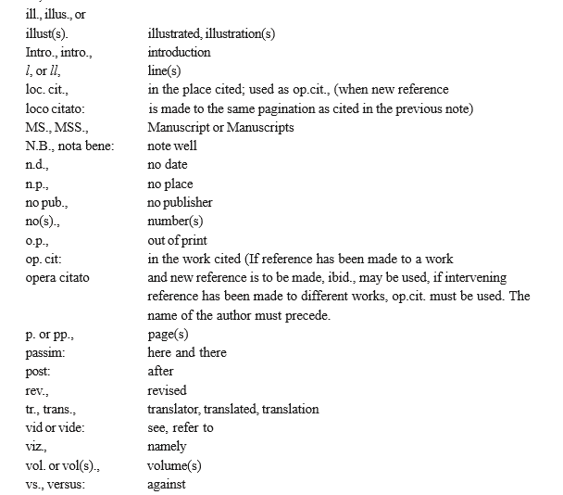
Mechanics of writing a research report continued….

Slide 71
Mechanics of writing a research report continued….
8. Use of statistics, charts and graphs:
9. The final draft
10. Bibliography:
11. Preparation of the index

Slide 72
PRECAUTIONS FOR WRITING RESEARCH REPORTS
Research report is a channel of communicating the research findings to the readers of the report. A good research report is one which does this task efficiently and effectively.
The following precautions needs to be followed:
1. While determining the length of the report (since research reports vary greatly in length), one should keep in view the fact that it should be long enough to cover the subject but short enough to maintain interest. In fact, report-writing should not be a means to learning more and more about less and less.
2. A research report should not, if this can be avoided, be dull; it should be such as to sustain reader’s interest.

Slide 73
PRECAUTIONS FOR WRITING RESEARCH REPORTS Continued….
3. Abstract terminology and technical jargon should be avoided in a research report. The report should be able to convey the matter as simply as possible. This, in other words, means that report should be written in an objective style in simple language, avoiding expressions such as “it seems,” “there may be” and the like.
4. Readers are often interested in acquiring a quick knowledge of the main findings and as such the report must provide a ready availability of the findings. For this purpose, charts,graphs and the statistical tables may be used for the various results in the main report in addition to the summary of important findings.

Slide 74
PRECAUTIONS FOR WRITING RESEARCH REPORTS Continued….
5. The layout of the report should be well thought out and must be appropriate and in accordance with the objective of the research problem.
6. The reports should be free from grammatical mistakes and must be prepared strictly in accordance with the techniques of composition of report-writing such as the use of quotations, footnotes, documentation, proper punctuation and use of abbreviations in footnotes and the like.
7. The report must present the logical analysis of the subject matter. It must reflect a structure wherein the different pieces of analysis relating to the research problem fit well.

Slide 75
PRECAUTIONS FOR WRITING RESEARCH REPORTS Continued….
8. A research report should show originality and should necessarily be an attempt to solve some intellectual problem. It must contribute to the solution of a problem and must add to the store of knowledge.
9. Towards the end, the report must also state the policy implications relating to the problem under consideration. It is usually considered desirable if the report makes a forecast of the probable future of the subject concerned and indicates the kinds of research still needs to be done in that particular field.
10. Appendices should be enlisted in respect of all the technical data in the report.

Slide 76
PRECAUTIONS FOR WRITING RESEARCH REPORTS Continued….
11. Bibliography of sources consulted is a must for a good report and must necessarily be given.
12. Index is also considered an essential part of a good report and as such must be prepared and appended at the end.
13. Report must be attractive in appearance, neat and clean, whether typed or printed.

Slide 77
PRECAUTIONS FOR WRITING RESEARCH REPORTS Continued….
14. Calculated confidence limits must be mentioned and the various constraints experienced in conducting the research study may also be stated in the report.
15. Objective of the study, the nature of the problem, the methods employed and the analysis techniques adopted must all be clearly stated in the beginning of the report in the form of introduction.
CONCLUSION:
In spite of all that has been stated above, one should always keep in view the fact report-writing is an art which is learnt by practice and experience, rather than by mere doctrination.

Slide 78
What is Intellectual Property (IP)?
Intellectual property (IP) pertains to any original creation of the human intellect such as artistic, literary, technical, or scientific creation. Intellectual property rights (IPR) refers to the legal rights given to the inventor or creator to protect his invention or creation for a certain period of time.

Slide 79
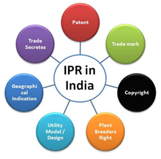
Different types of IPs
Copyright
Related Rights
Trademarks
Geographical Indications
Industrial Designs
Patents

Slide 80
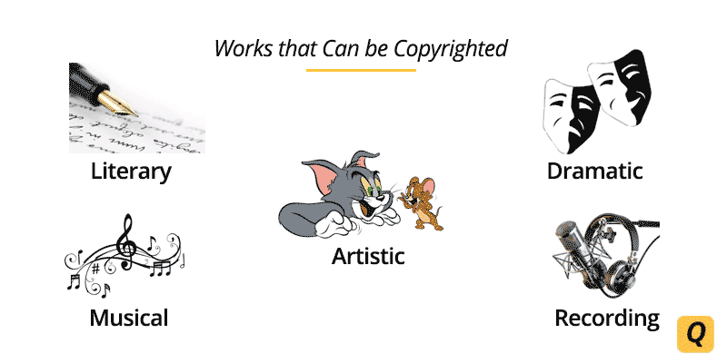

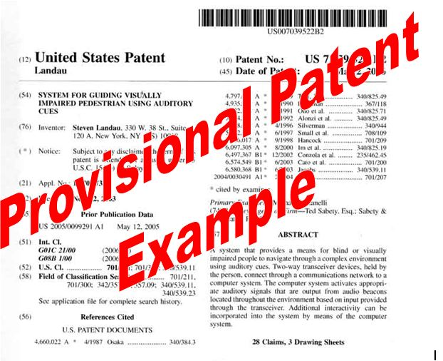
Copyright – It is the right that protects a tangible form of expression like book, painting etc. It protects the mannerism in which the idea is expressed.
Trademark – It refers to the protection of logo or design that an individual or company uses. The distinguished logo or design helps the customers to connect with the brand value and thereby ensure trust on the goods and services.
Patent– A patent is used to prohibit the use, selling, by another party for a defined period of time, of original production. In brief, a sovereign authority awards the inventor the IP right after an examination of its viability.

Slide 81
Key Points
Copyright
The Indian Copyright Act 1957 [Amended in 1982, 1984, 1992, 1994 & 1999]
Authors lifetime + 50 years from the end of the calendar year in which author dies
50 years for films and sound recordings
25 years for typographical arrangements of a published edition

Slide 82
Works Not Covered By Copyright
https://www.dmlp.org/legal-guide/works-not-covered-copyright
Facts
You can use facts in your online work without the fear of liability because facts are not protected under copyright law.
For example, baseball scores, telephone numbers, dates of birth, and the number of people at a protest are noncopyrightable facts.
Works Not Fixed in a Tangible Form of Expression
Copyright protection only applies to "original works of authorship" that are "fixed in a tangible medium of expression.
Ideas, concepts, or principles
You become the copyright owner only when you put that idea into "expression" through words (e.g., in a blog post) or other tangible form (e.g., in a video, a photograph, or a podcast).

Slide 83
Works Not Covered By Copyright continued...
Words, Phrases, or Familiar Symbols
In general, copyright does not protect individual words, short phrases, and slogans; familiar symbols or designs; or mere variations of typographic ornamentation, lettering, or coloring; mere listings of ingredients or contents.
Trademark law protects certain words, short phrases, slogans, symbols, and designs. For example, trademark law protects the word "Apple," the slogan "Got Milk?" and the Nike symbol of the "swoosh.
Works in the Public Domain

Slide 84
Key Points
Trademark
It is covered under the act called the Trade Marks Act, 1999
It is valid for 10 years from the date of application which may be renewed for further for 10 years on the payment of prescribed fees.

Slide 85
What Cannot Be Registered As Trademark In India?
https://cleartax.in/s/cannot-registered-trademark-india

Slide 86
Patent Acts
https://ipindia.gov.in/writereaddata/Portal/IPOAct/1_31_1_patent-act-1970-11march2015.pdf
Patent: – A patent is used to prohibit the use, selling, by another party for a defined period of time, of original production. In brief, a sovereign authority awards the inventor the IP right after an examination of its viability.
It is covered under the act called patent act 1970 [Amended by patent act 2005]
Term of patent is 20 years from the date of filing for all types of inventions.

Slide 87
What is not patentable in India
(Section 3 of the (Indian) Patents Act, 1970
https://www.mondaq.com/india/patent/100320/what-is-not-patentable-in-india
The following are not patentable in India:-
An invention, that is frivolous or that claims anything obviously contrary to well established natural laws;
An invention, the primary or intended use of which would be contrary to law or morality or injurious to public health;
The mere discovery of a scientific principle or the formulation of an abstract theory;
The mere discovery of any new property or new use for a known substance or of the mere use of a known process, machine or apparatus unless such known process results in a new product or employs at least one new reactant;
A substance obtained by a mere admixture resulting only in the aggregation of the properties of the components thereof or a process for producing such substance;
The mere arrangement or rearrangement or duplication of known devices, each functioning independently of one another in a known way;

Slide 88
What is not patentable in India continued...
A method of agriculture or horticulture;
Inventions relating to atomic energy.
Any process for the medicinal, surgical, curative, prophylactic or other treatment of human beings or animals.
Plants and animals in whole or any part thereof other than microorganisms.
Mathematical or business method or a computer program per se or algorithms.
literary, dramatic, musical or artistic works, cinematographic works, television productions and any other aesthetic creations.
Mere scheme or rule or method of performing mental act or playing game.
Presentation of information.
Topography of integrated circuits.
An invention which in effect, is traditional knowledge or is based on the properties of traditional knowledge.

Slide 89
IPs importance in the present scenarios
In the modern era, Intellectual property rights plays a significant role on trade of every nation.
In this digitized world, there stands a higher risk of creative ideas getting stolen without the consent of the author.
The need for strong IP laws gives an overall contribution in the economy of the respective state.
IPR is one of the sources of security for intangible properties which are still open to the public and which can be quickly replicated by anyone.
IP crimes have become the part and parcel of the digitized era leading to failure of business.

Slide 90
IPs importance in the present scenarios
Innovative idea means to earn profit
Export Business Opportunities
Encourage the ideas by securing them
Business Growth

Slide 91
Patent Acts
IP Acts: Introduction to IP
https://blog.ipleaders.in/what-is-a-patent-law-in-india/
https://ipindiaservices.gov.in/PatentSearch/PatentSearch/ViewApplicationStatus
APPLICATION NUMBER | 202021038154

Slide 92
Indian Patent Acts 1970
IP Acts: Introduction to IP
https://ipindia.gov.in/writereaddata/Portal/IPOAct/1_31_1_patent-act-1970-11march2015.pdf

Slide 93
Design Act
Design means only the features of shapes, configuration, pattern, ornament or composition of lines or colours applied to any article whether in 2D or 3D or in both forms. By any industrial process or means, whether manual, mechanical or chemical, separate or combined, which in the finished article appeal to and are judged solely by the eye; but does not include any mode or principle of construction or anything which is in substance a mere mechanical device.

Slide 94
Industrial design Act 2000
IP Acts: Introduction to IP
This act may be called the Design Act, 2000
It extends to the whole of India
https://ipindia.gov.in/writereaddata/Portal/Images/pdf/Check_list_for_DESIGN_APPLICATION.pdf

Slide 95
Copyrights acts 1957
https://copyright.gov.in/documents/copyrightrules1957.pdf

Slide 96
Trade Mark Act 1999
https://legislative.gov.in/sites/default/files/A1999-47_0.pdf
https://www.indiacode.nic.in/handle/123456789/1993?locale=en

